Slide 1

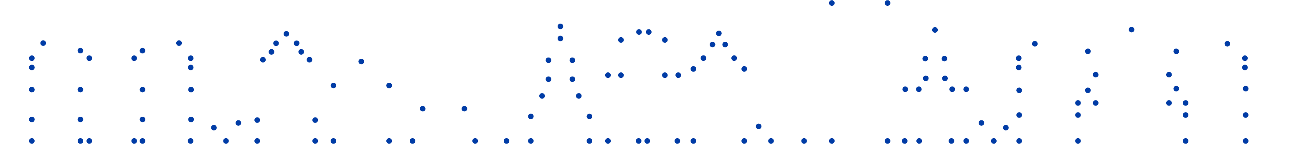
From Debate to Dialogue:
Communication across sectors and communities
@OliverEscobar
Edinburgh Futures Institute / University of Edinburgh
AGM December 2020
North West Glasgow Voluntary Sector Network

Slide 3
Anchor neighbourhoods and SUIs’ projects
G
o
v
a
n
a
n
d
G
r
e
a
t
e
r
G
o
v
a
n
(
G
l
a
s
g
o
w
)
K
i
nn
i
n
g
P
a
r
k
C
o
m
p
l
e
x
G
o
v
a
n
W
o
r
k
s
p
a
c
e
s
G
o
v
a
n
H
e
r
i
t
a
g
e
T
r
u
s
t
N
o
r
t
h
W
e
s
t
P
l
a
n
t
a
t
i
o
n
P
r
o
d
u
c
t
i
o
ns
G
o
v
a
n
H
o
u
s
i
n
g
As
s
o
c
i
a
t
i
o
n
(
C
o
p
e
n
h
a
g
e
n
)
S
u
n
n
y
G
o
v
a
n
R
a
d
i
o
G
l
a
s
g
o
w
C
i
t
y
C
o
u
nc
i
l
,
C
o
m
m
u
n
i
t
y
p
l
a
nn
i
n
g
G
o
v
a
n
C
o
m
m
u
n
i
t
y
P
r
o
j
e
c
t
L
o
k
a
l
u
d
v
a
l
g
B
i
s
p
e
b
j
e
r
g
U
r
b
a
n
R
o
o
t
s
O
m
r
å
d
e
f
o
r
ny
e
l
s
e
n
N
o
r
d
v
e
s
t
C
e
n
t
r
a
l
G
o
v
a
n
A
c
t
i
o
n
P
l
a
n
N
v
æ
r
k
e
t
F
a
b
l
a
b
N
o
r
d
v
e
s
t
V
i
t
a
g
e
r
g
a
d
e
r
n
e
t
i
l
b
a
g
e
N
o
r
d
v
e
s
t
F
æl
l
e
s
s
k
a
b
e
t
M
o
r
s
M
a
dp
a
k
k
e
S
p
a
r
k
b
r
o
o
k
a
n
d
B
a
l
s
a
l
l
O
s
d
o
r
p &
H
e
a
t
h
(
B
i
r
m
i
n
g
h
a
m
)
S
l
o
t
e
r
m
e
e
r
-
S
l
o
t
e
r
v
a
a
r
t
A
s
h
i
a
n
a
C
o
m
m
u
n
i
t
y
P
r
o
j
e
c
t
(
A
m
s
t
e
r
d
a
m
)
U
n
i
t
y
S
t
r
e
e
t
s
T
e
l
l
M
a
m
a
U
K
L
u
c
a
s
C
o
m
m
u
n
i
t
y
S
a
h
e
l
i
p
r
o
j
e
c
t
C
o
m
b
i
w
e
l
W
om
e
n
’
s
E
n
t
e
r
p
r
i
s
e
H
u
b
B
u
u
r
t
w
e
r
k
p
la
a
t
s
O
l
d
P
r
i
n
t
W
o
r
k
s
I
m
p
u
l
s
I
n
d
e
p
e
n
d
e
n
t c
o
n
s
u
l
t
a
n
t
/
a
c
t
i
v
i
s
t
W
e
s
t
s
i
d
e
/
V
l
u
g
t
la
a
n
M
e
l
a
E
n
t
e
r
p
r
i
s
e
s
N
i
s
a4
N
i
s
a
C
h
u
r
c
h
o
f
E
n
g
l
a
n
d D
i
o
c
e
s
e
E
S
A
N
K
S
I
C
M
(
C
l
i
f
t
o
n
r
o
a
d
m
o
s
q
u
e
)
Y
o
u
n
g
N
i
e
u
w
W
e
s
t
P
o
d
n
o
s
h
B
u
u
r
t
z
a
a
k
S
a
m
e
n
w
o
n
e
n
/
S
a
m
e
n
l
e
v
e
n
C
on
c
o
r
d
Y
o
u
t
h
C
e
n
t
r
e
V
r
o
u
w
e
n
V
a
a
r
t
(
B
i
r
m
i
n
gh
a
m
I
s
l
a
m
i
c
S
o
c
i
e
t
y
a
n
d
H
o
p
e
n
o
t
H
a
t
e
Z
I
D
t
h
e
a
t
e
r
W
M
)
H
o
g
e
s
c
h
oo
l
U
t
r
e
c
h
t
C
on
c
o
r
d
Y
o
u
t
h
C
e
n
t
r
e
L
P
B
K
I
K
I
T –
P
a
t
h
w
a
y
s
t
o
r
e
c
o
v
e
r
y
g
e
m
e
e
n
t
e
Z
u
t
p
h
e
n
P
a
i
gh
a
m
e
l
-
A
s
l
a
m
T
r
u
s
t
L
S
A
-
B
e
w
o
n
e
r
s
M
o
s
e
l
e
y
R
o
a
d
B
a
t
hs –
B
o
a
r
d
o
f
T
r
u
s
te
e
s

Slide 4
Tensions
COLLABORATING
INNOVATING
SUSTAINING
CONSTESTING

Slide 5
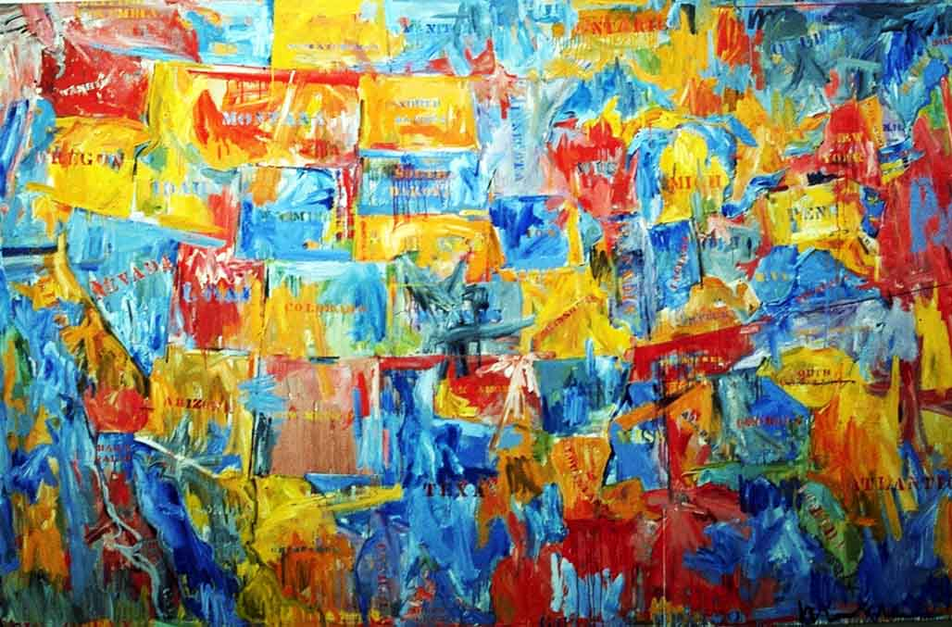
Society as a web of communication patterns
Different patterns of communication create different interpersonal contexts
Communication is not only instrumental, but also consequential:
  Importance of what gets done (results, outputs)
  but also what gets made (relationships, contexts)
  and how it gets made (through what communication patterns; with what consequences)

Slide 6

Communication patterns
Interactions or relationships that, once developed,
tend to replicate themselves by generating situations that perpetuate those interactions and repel the alternatives
(Pearce 2007:158)

Slide 7

Examples of communication patterns:
common rituals and pitfalls
Exchanging monologues and/or pre-packaged arguments
Dominant voices
Posturing / peacocking
(Ab)using jargon
Spiral of silence and avoidance (leads to groupthink)
Polarisation and oversimplifaction
Confrontational exchanges
Notes:
7

Slide 8
What is deliberative democracy?
Democracy should be more than counting heads: it must involve dialogue and deliberation “on an equal and inclusive basis, which deepens participants’ knowledge of issues, awareness of the interests of others, and the confidence to play an active part in public affairs” (Saward 2000:5)
deliberative democrats argue that decision-making should be based on reasoned public dialogue and deliberation, where no force other than the force of the better argument should prevail (Habermas 1975)
The goal of public dialogue and deliberation is to make organisations & authorities responsive to reasons and evidence, not just the power of numbers, money, position, status or interests

Slide 9
Debate | Dialogue | Deliberation
Seeks to promote opinions and gain majority support | Seeks to build understanding and relationships | Seeks common ground in order to solve problems
Participants argue, express, persuade and compete | Participants listen, exchange, reach across, reflect | Participants frame and weigh options, and make choices
Outcome: win/lose | Outcome: no decision | Outcome: decision – win/win

Slide 10
PIN diagram (Andrew Acland)
Win-Lose
Positions
visibility line
Interests & values
Needs & concerns
Win-Win

Slide 11
Public Dialogue and Deliberation (Escobar 2011)
Forms of conversation and discussion that focus on developing understanding, relationships and informed decisions
Creation of safe spaces to explore conflict and difference
Suspension of assumptions and automatic response (assimilation/opposition)
Finding common ground / exploring differences
Co-creation of shared meanings and language
Collaborative inquiry / considered judgement
Storytelling / testimony
Understanding the contribution of emotions

Slide 12
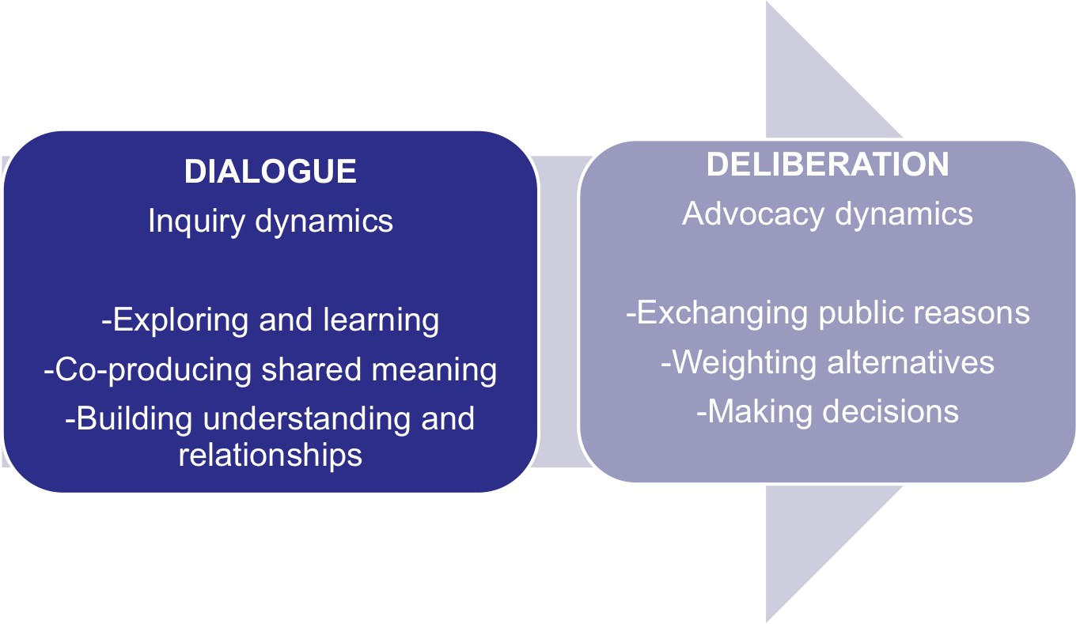
The D+D model
Notes:
12

Slide 13
Why dialogue and deliberation matter in cross-sector communication?
It helps to reach decisions that are well justified and fair
It builds understanding and consent for decisions we may disagree on
It can transform uninformed views and preferences through open and inclusive conversations
It can avoid ‘groupthink’ and the ‘echo chamber effect’
Talk without action can be toothless but action without talk can be mindless

Slide 14
Conclusions and reflections
D+D are challenging when there are profound power inequalities and power differentials are abused
Changing existing patterns takes strategic thinking, practical know-how, and the courage to try something different
But although you can initiate D+D, ultimately it depends on others whether they want/can take up the invitation
It’s important to think about the architecture of incentives for D+D
  Interdependence
  Countervailing power: activism, advocacy, pressure
Back to the dilemma between collaboration and contestation – what is the right thing to do at what stage?
FROM ‘we don’t have power to…’ To ‘what kind of power we have and how do we use it’

Slide 15
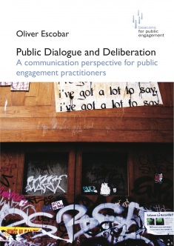

Open access PDF
@OliverEscobar

